Slide 1
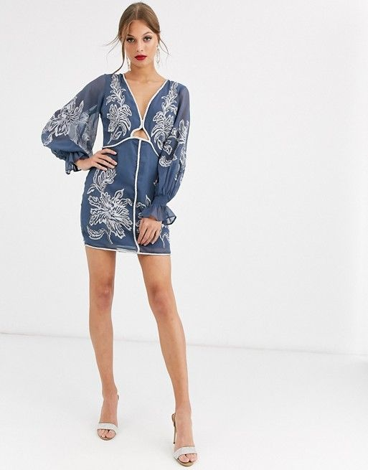
Asos Spring Dresses

